Slide 1
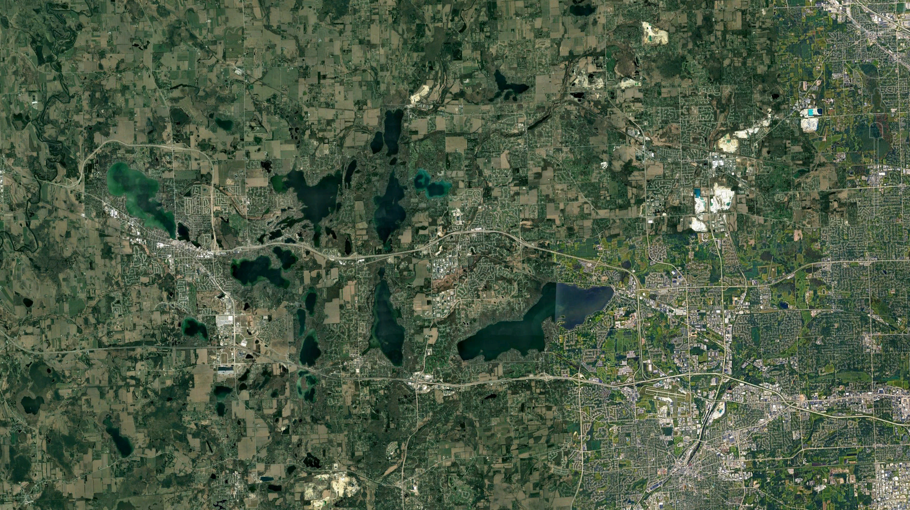
Ecological memory of climate and land use change shapes water quality across >650 widespread lakes
Abigail Lewis, Wei Zhi, Juliane Mai, Nandita Basu, Cayelan Carey
Notes:
7 minutes for presentations (2 min for Q&A)1 - SO SHORT! Presentation Length: 08:39 – 08:48 PST
Add affiliations (Waterloo, VT logos)

Slide 2
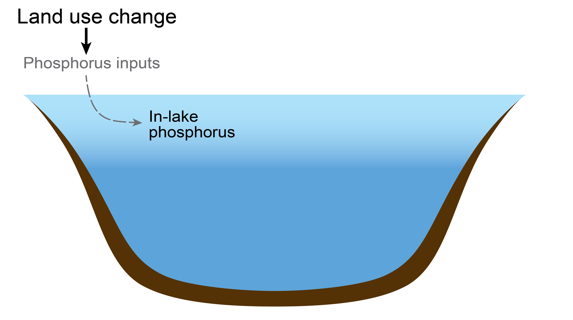
Ecological memory of climate and land use may shape water quality over multiple timescales
Lewis et al. in press GCB
Notes:
Notes: talking about P because of data availability

Slide 3
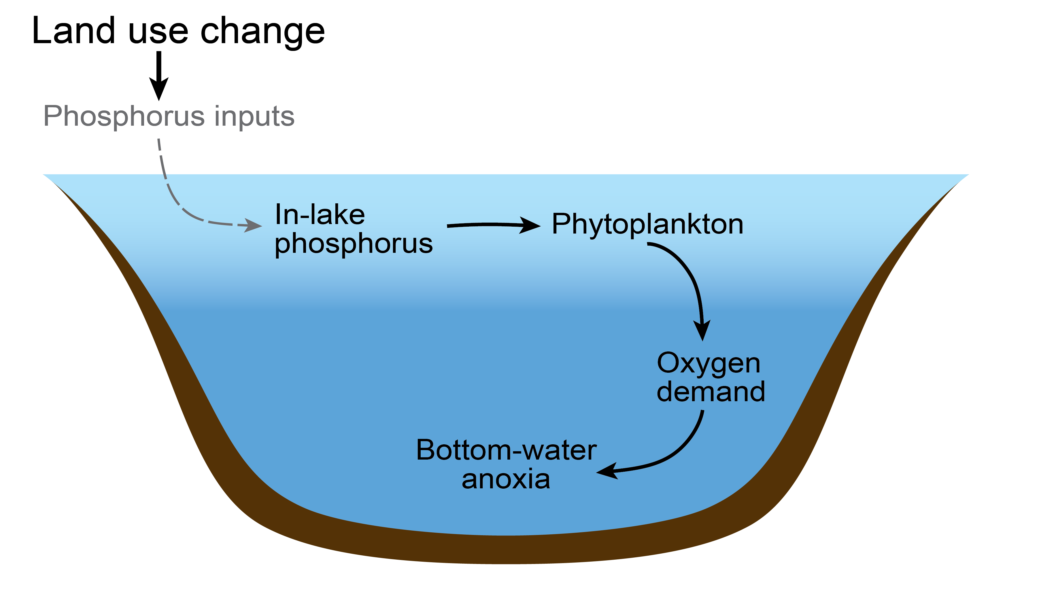
Ecological memory of climate and land use may shape water quality over multiple timescales
Lewis et al. in press GCB
Notes:
Notes: talking about P because of data availability

Slide 4
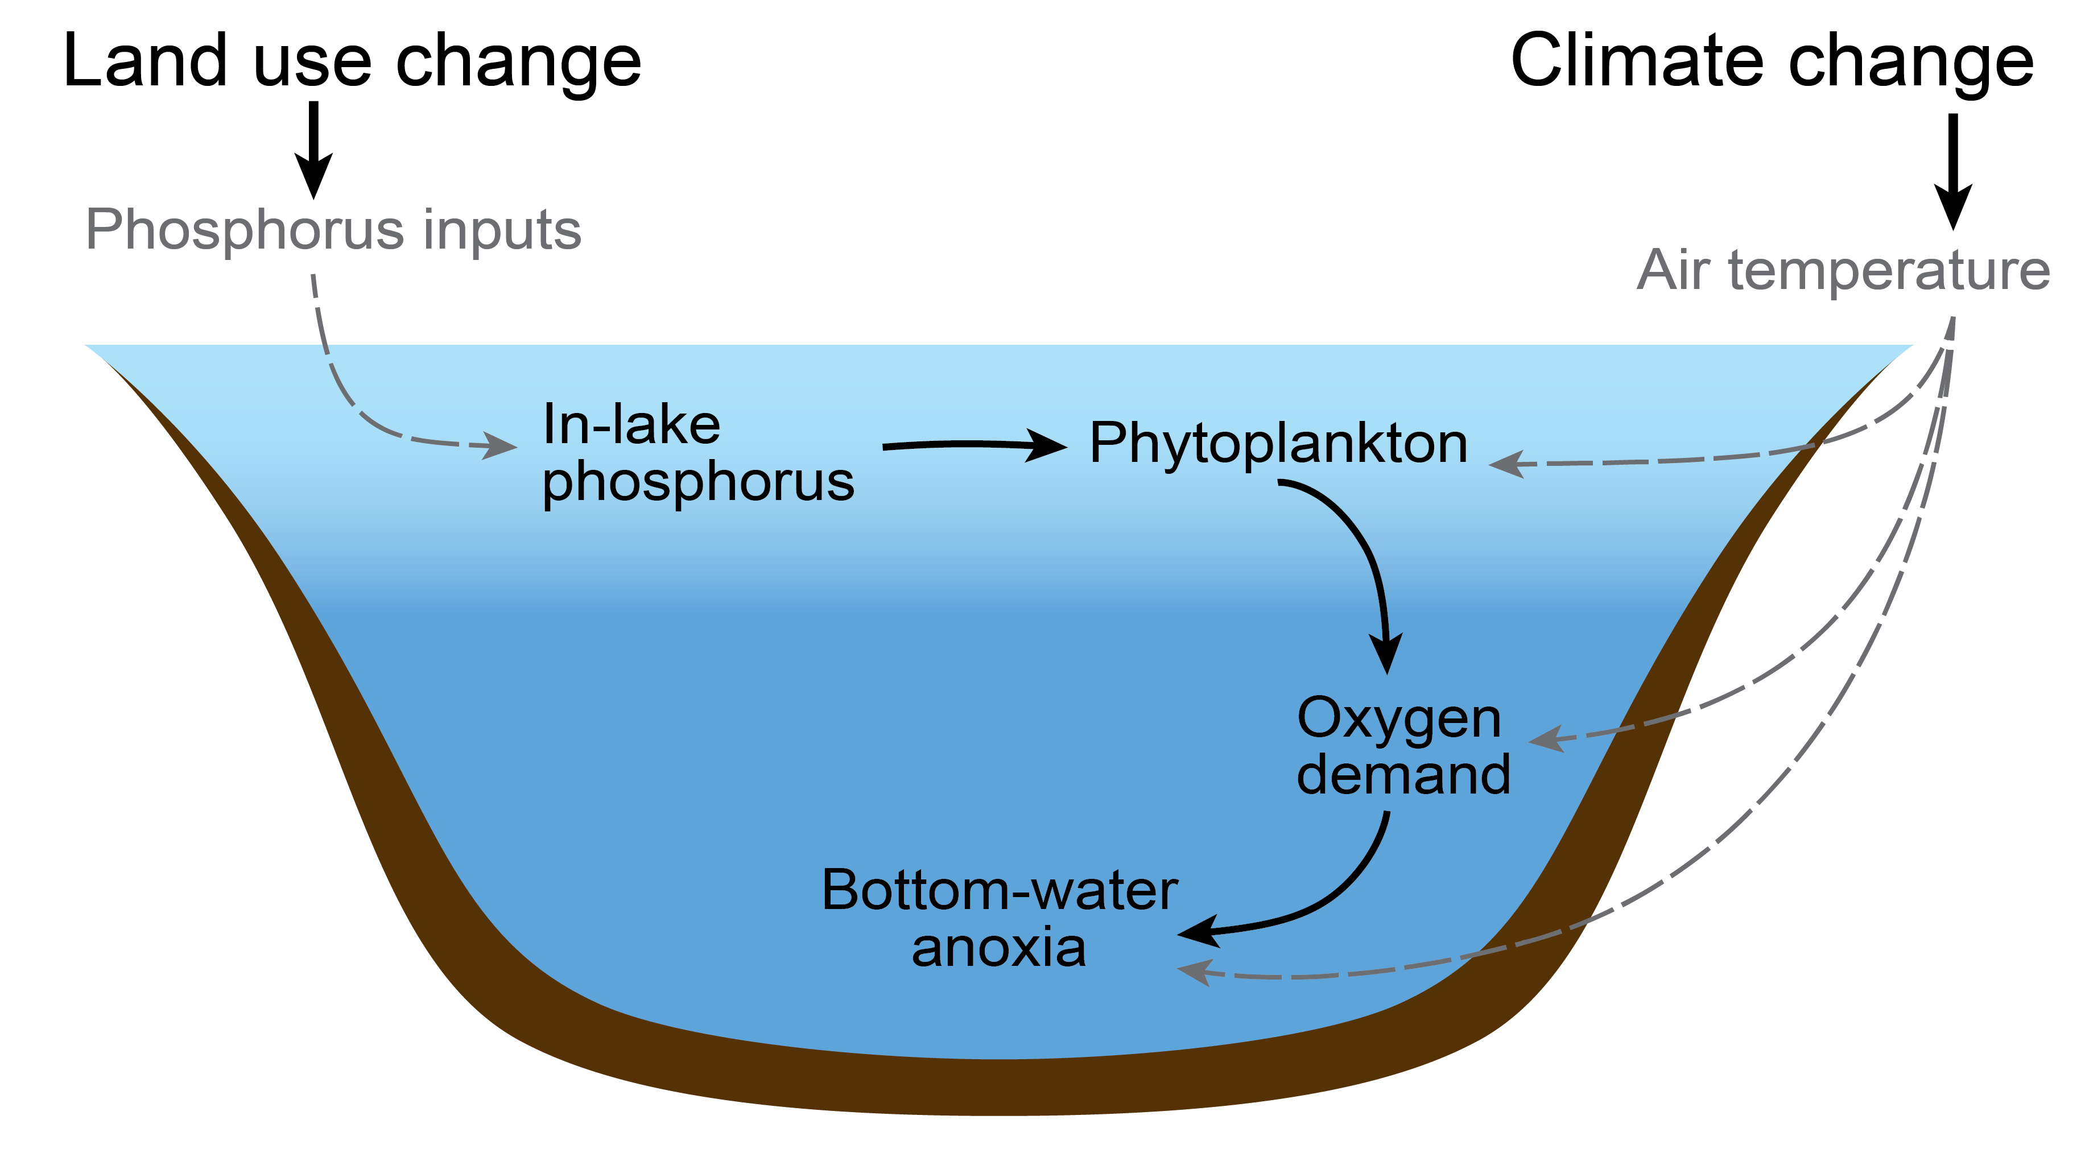
Ecological memory of climate and land use may shape water quality over multiple timescales
Lewis et al. in press GCB
Notes:
Notes: talking about P because of data availability
Cut script here- think about audience (not too much background)

Slide 5
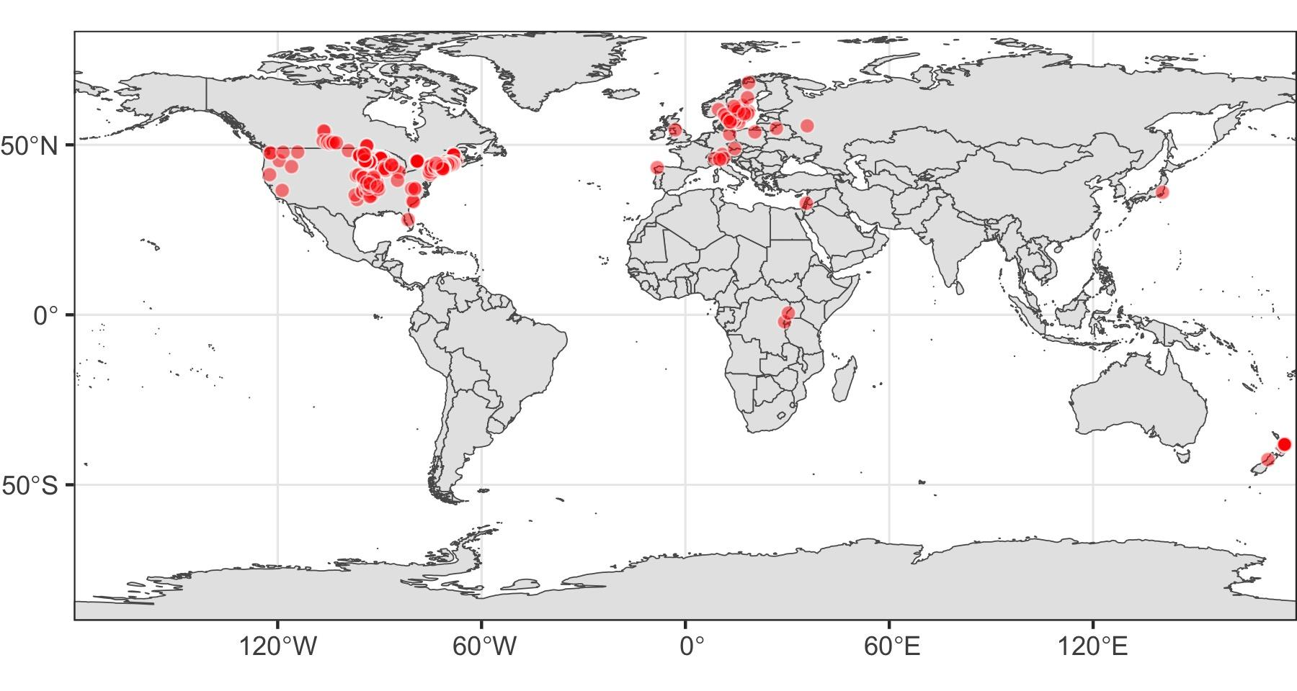
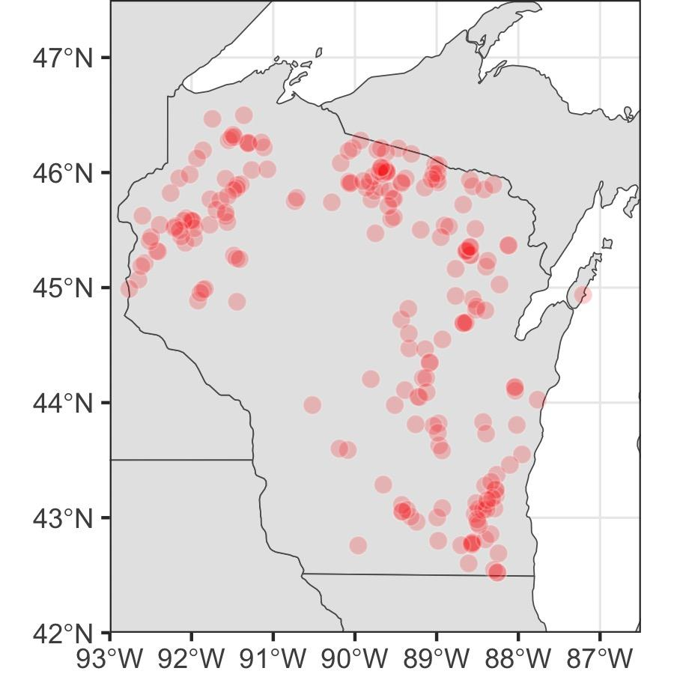
We synthesized data from >650 lakes to characterize memory effects of both climate and land use
Land use: in-depth analysis of Wisconsin lakes
Modeled phosphorus inputs
Lewis et al. in press GCB
Climate: broad geographic distribution
Temperate stratified lakes in 18 countries
Median of 30 years of data at each lake
Notes:
One area with consistent climate effects to focus on land use

Slide 6
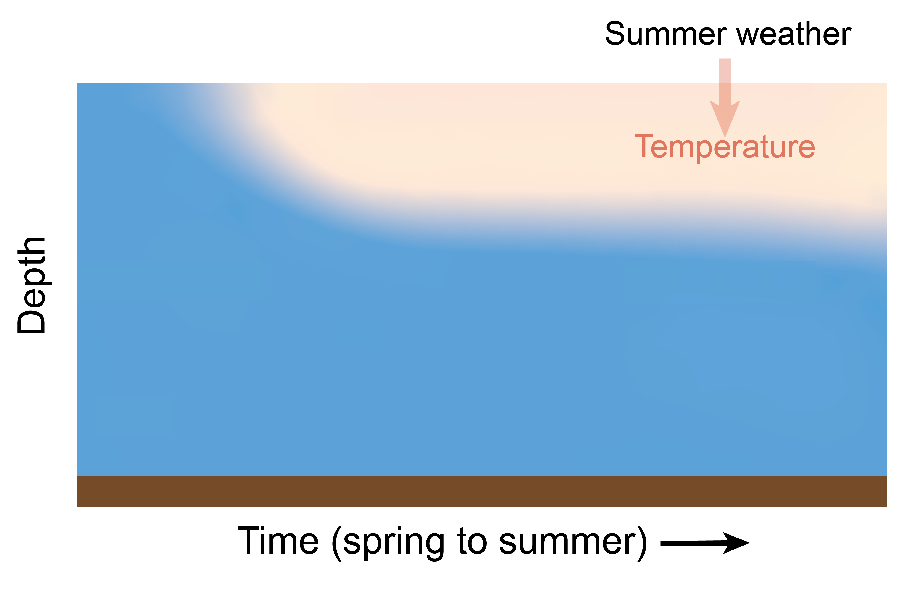
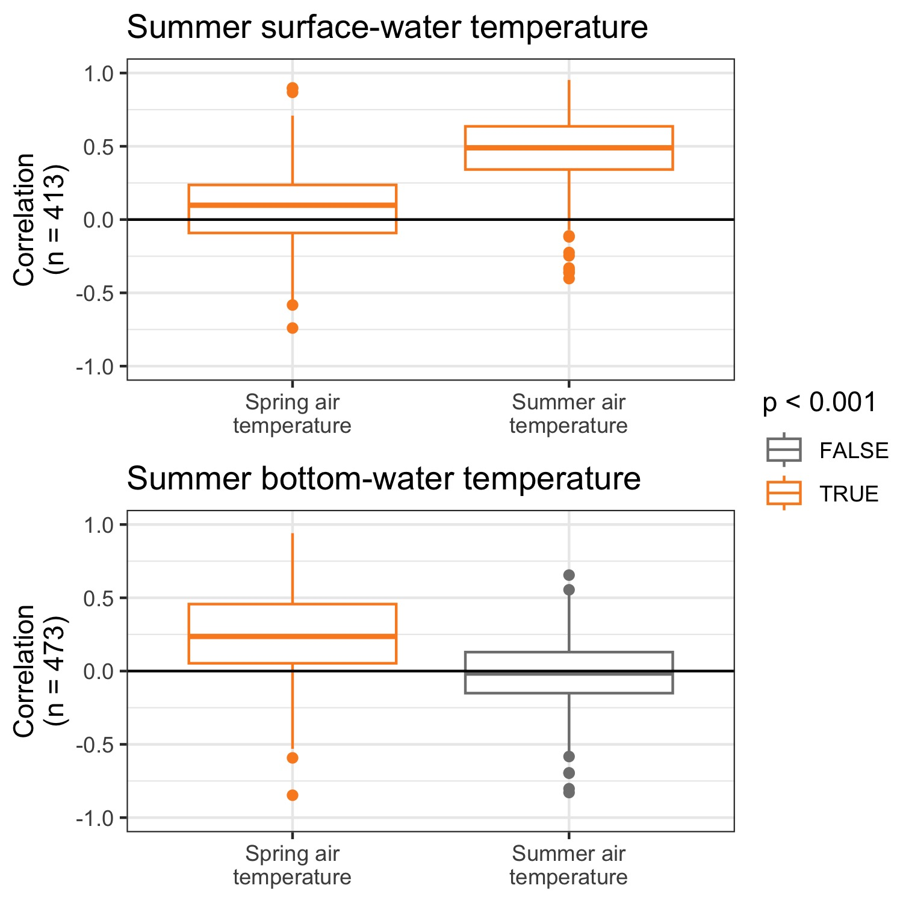
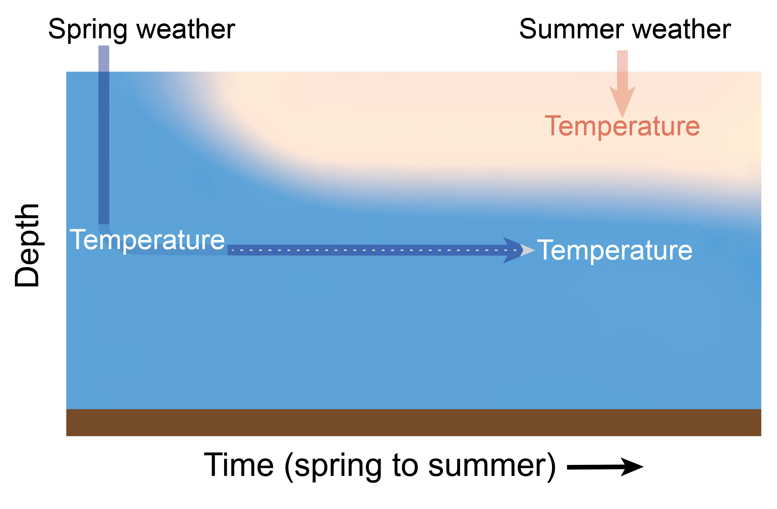
Summer surface-water temperature is correlated with summer air temperature
Climate
Conversely, summer bottom-water temperature is correlated with spring air temperature
Notes:
Move legend to the side
Make sure x axis title is there originally
Add box on figure on left
Have y axis text bigger, maybe not rotated, bold surface and bottom
August surface water temperature, august bottom water as title
Only spring and summer (one month)
Write main finding
Title is too complicated→ two sentences that appear separately
Remove top letters
Break apart spring and summer, add parallel arrows
Spring air temp, water temp in diagram

Slide 7
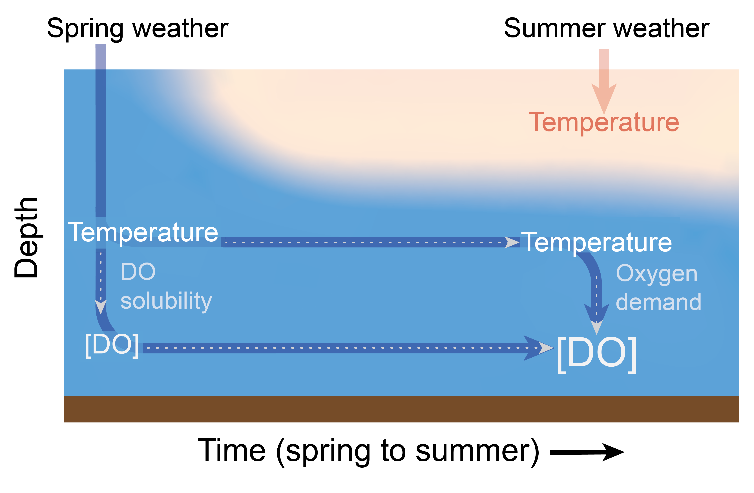
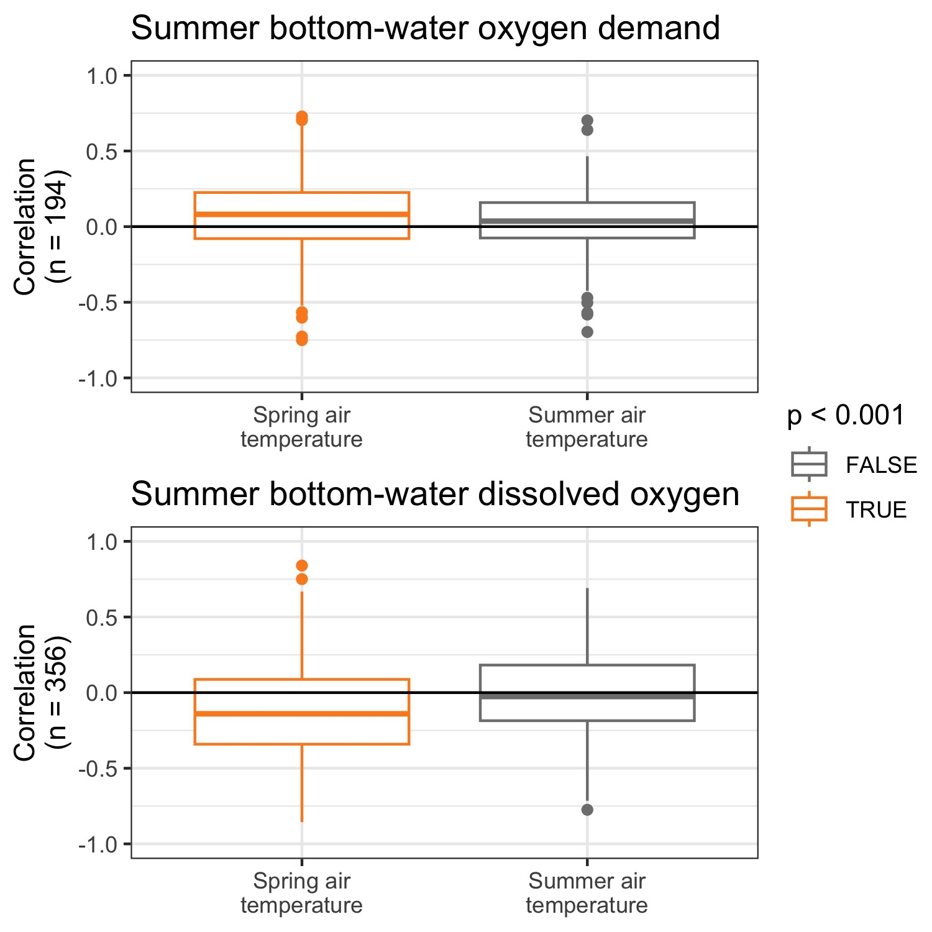
Ecological memory of spring air temperatures controls summer bottom-water oxygen dynamics
Climate

Slide 8
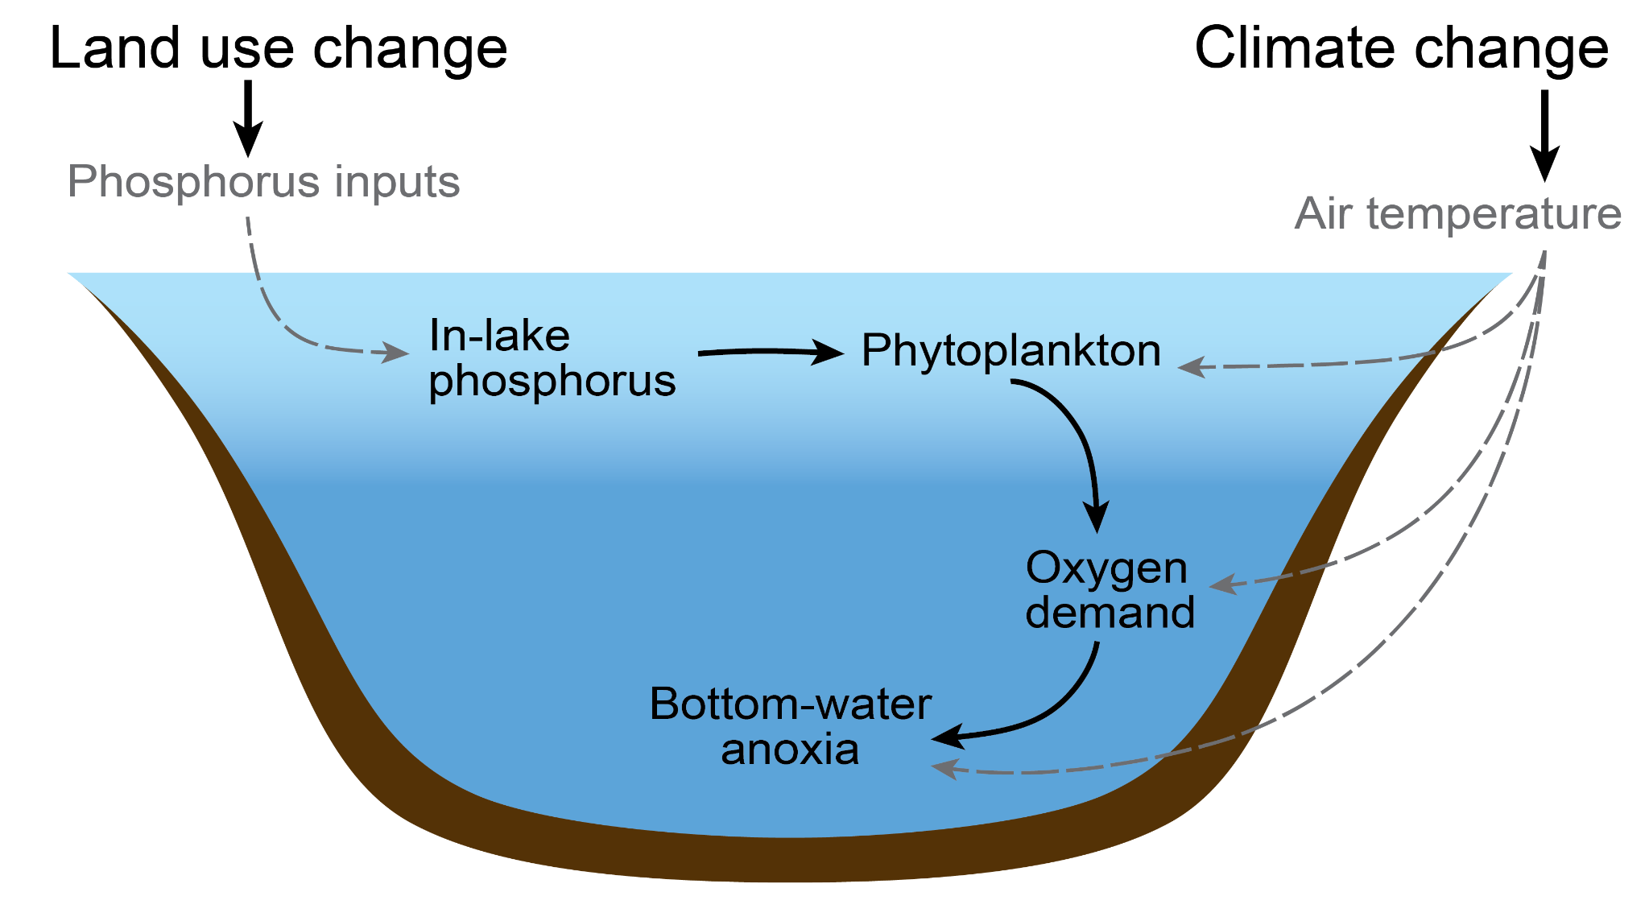
Nutrient inputs could be directly correlated with in-lake concentrations, or may exhibit legacy effects
Land use
Notes:
Exciting new opportunity to pair modeled TP inputs and in-lake TP concentrations

Slide 9

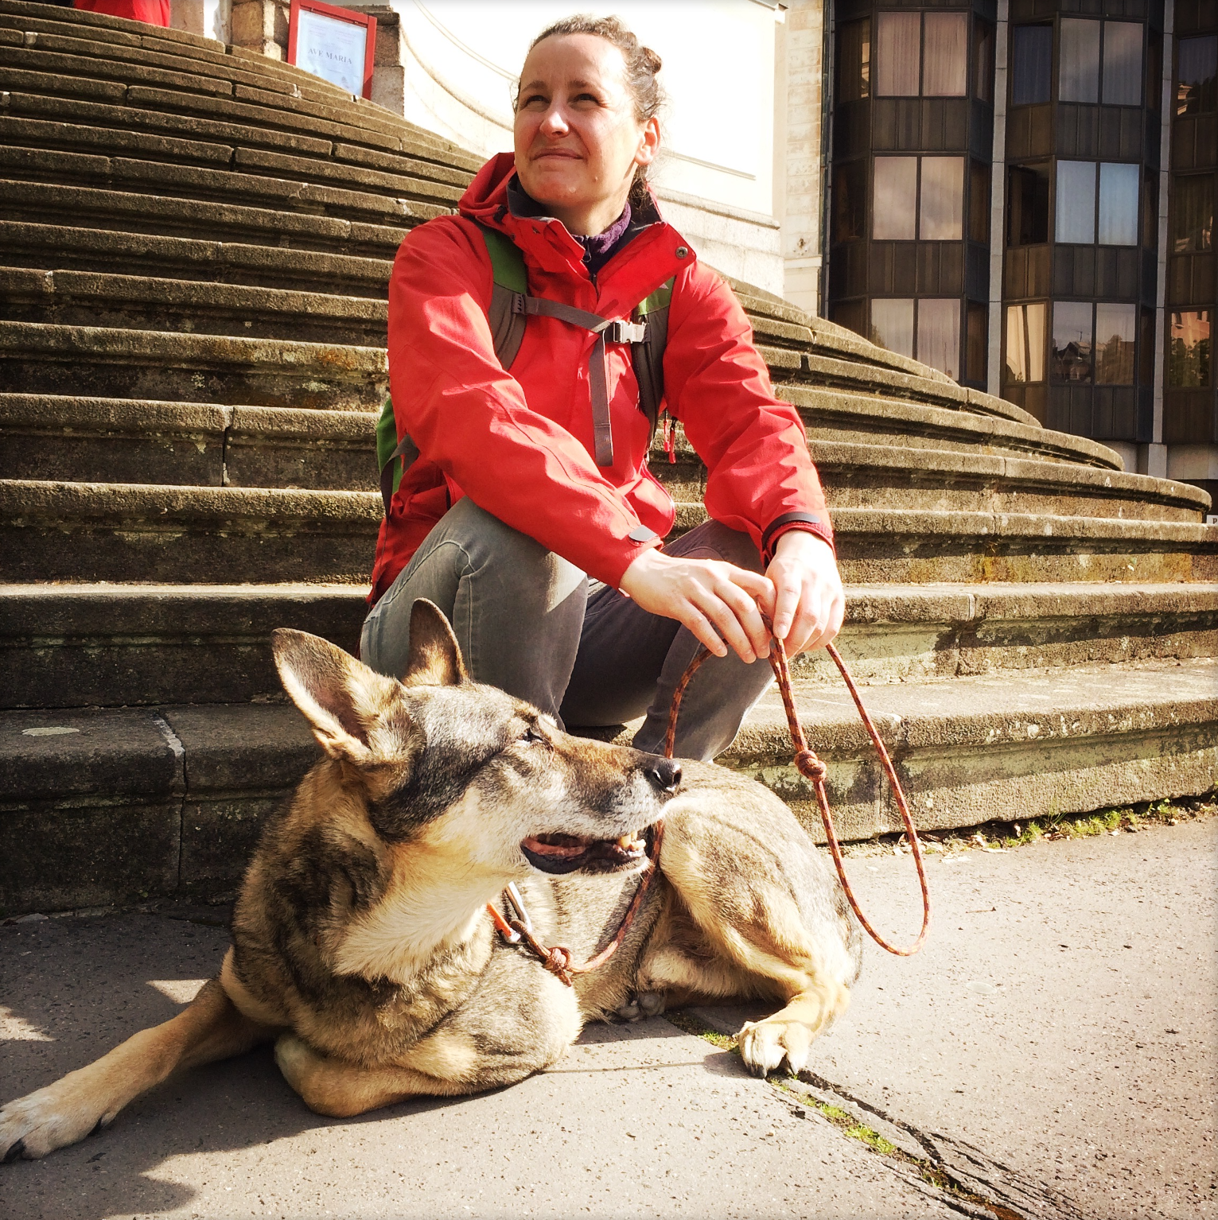



TP inputs were modeled for each lake using climate and land use data
Land use
Streamflow model
Climate driver data
Modeled streamflow
TP
Dr. Juliane Mai
University of Waterloo
Dr. Wei Zhi
University of Waterloo
Now: Hohai University
Phosphorus model
TP input timeseries
Phosphorus timeseries data (land use, wastewater)

Slide 10
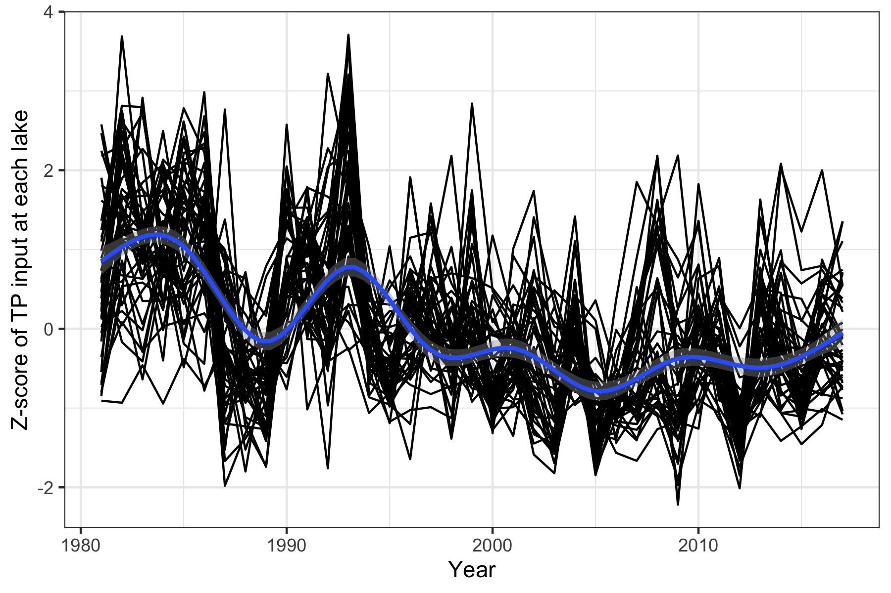
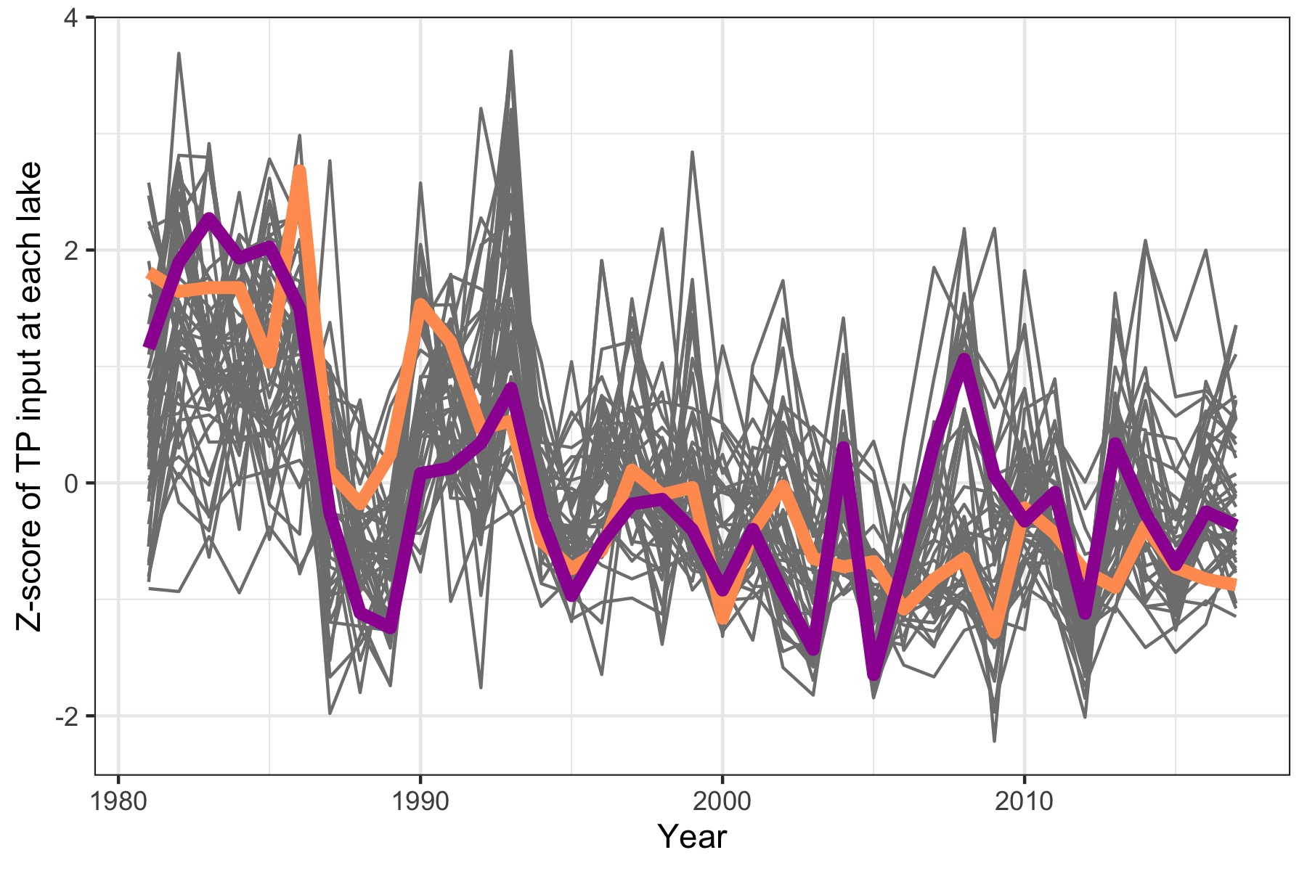
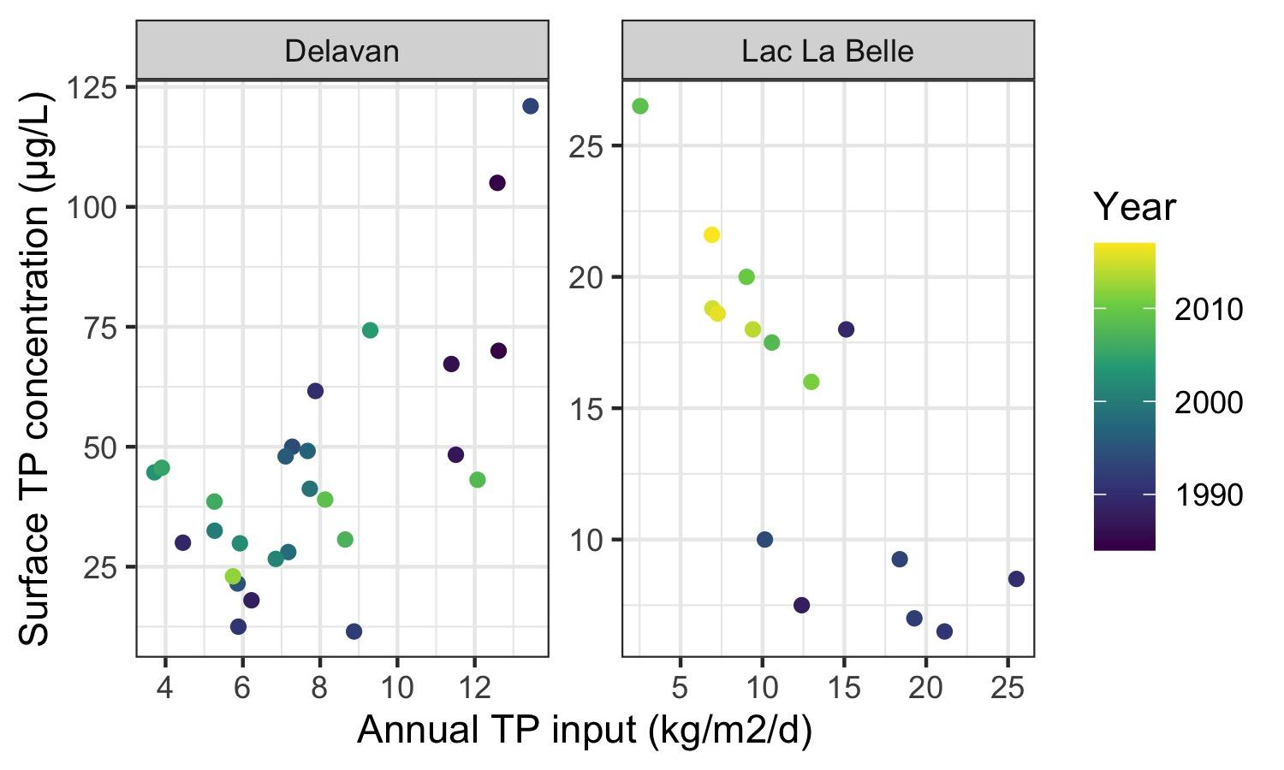
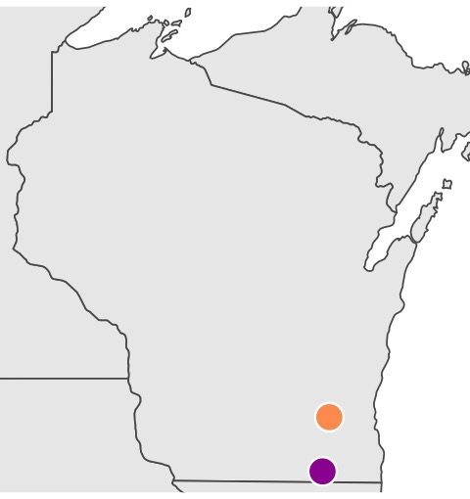
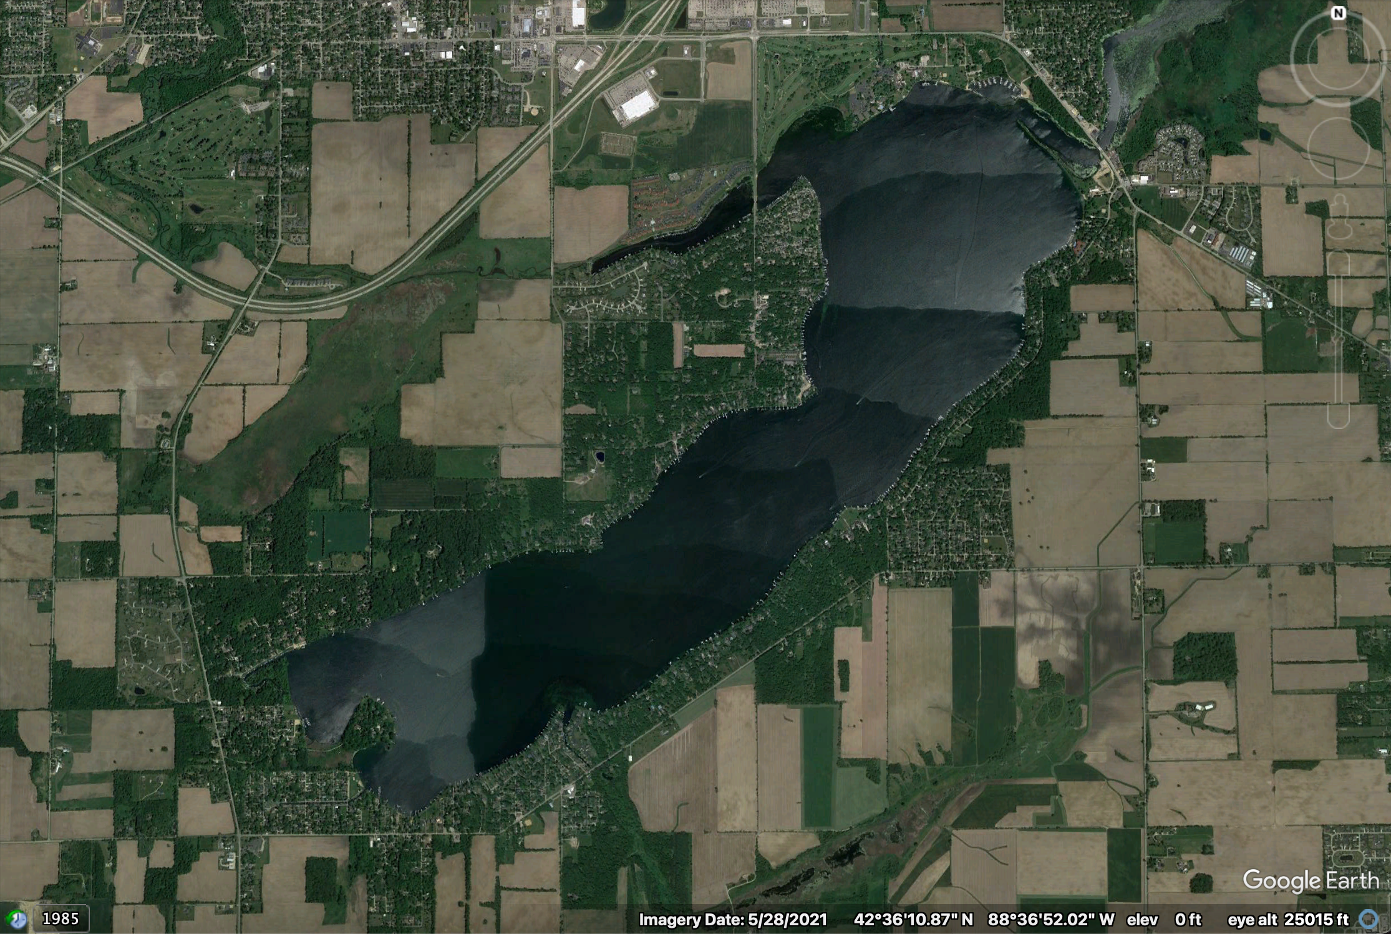
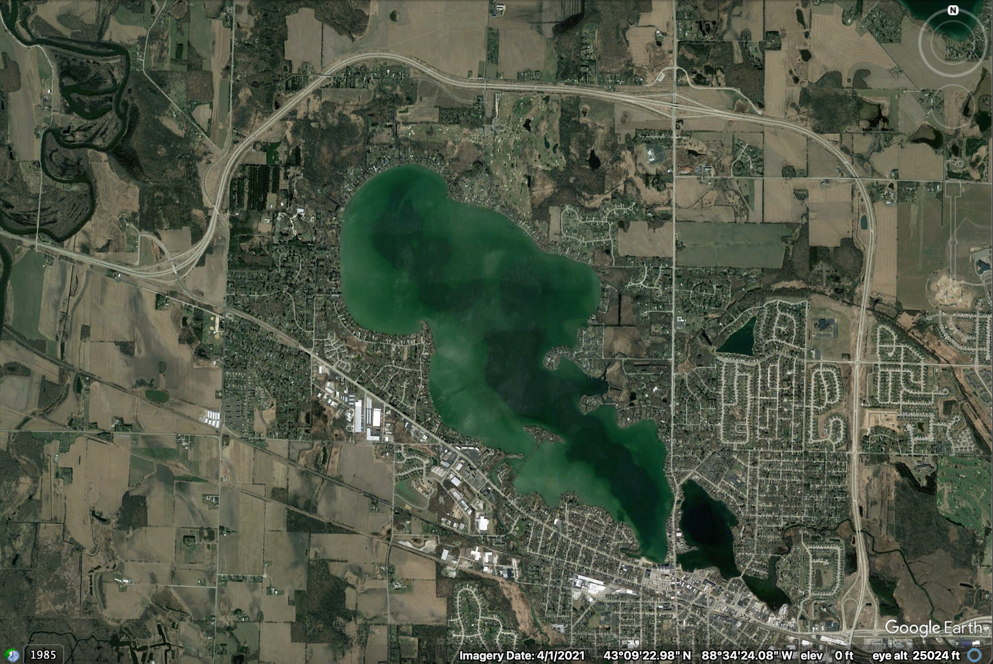
Preliminary results suggest legacy effects of nutrient loading in some Wisconsin lakes
Land use
Divergent patterns of in-lake responses
Delavan
Lac La Belle
Across lakes, TP inputs tended to decrease from ca. 1980–2000, then stabilize
Notes:
Don’t have time to talk about all lakes, so I’m going to tell the story of two lakes.
Talk about spring temp in these two lakes
Both lakes have hypo temps positively correlated with April air temps
Outline the lakes
Bonus slide with same limits

Slide 11
Next steps
What lake or catchment characteristics determine the strength of ecological memory for air temperatures and nutrient inputs?
What is the relative importance of climate and land use in shaping water quality? How does the relative importance vary across space and time?
Notes:
Short script here

Slide 12
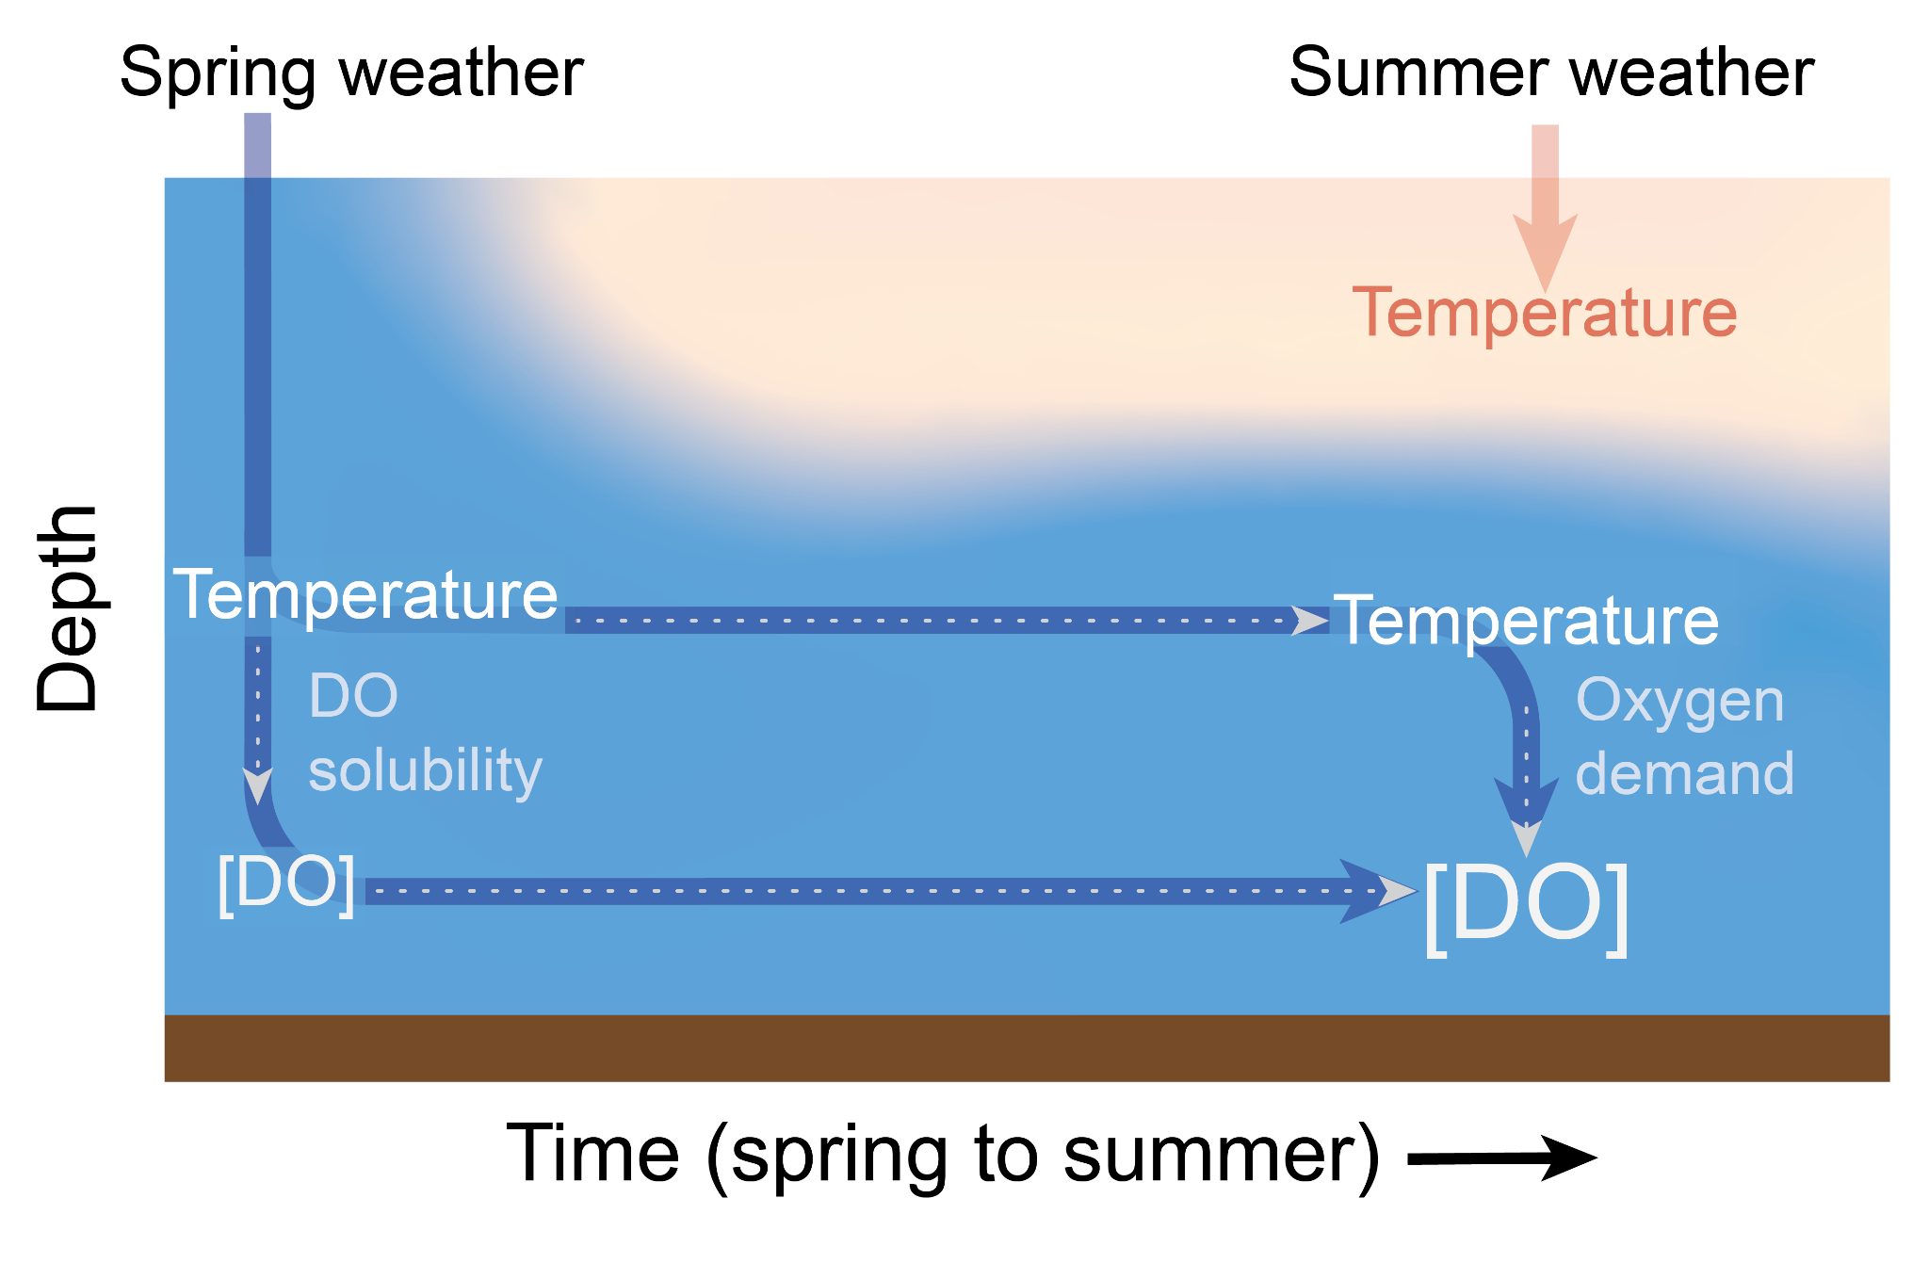
Ecological memory shapes water quality dynamics, both within and across years
Spring air temperature is a key determinant of summer (August) bottom-water dissolved oxygen
Effects of nutrient loading are difficult to identify within and across lakes, potentially due to legacy effects

Slide 13

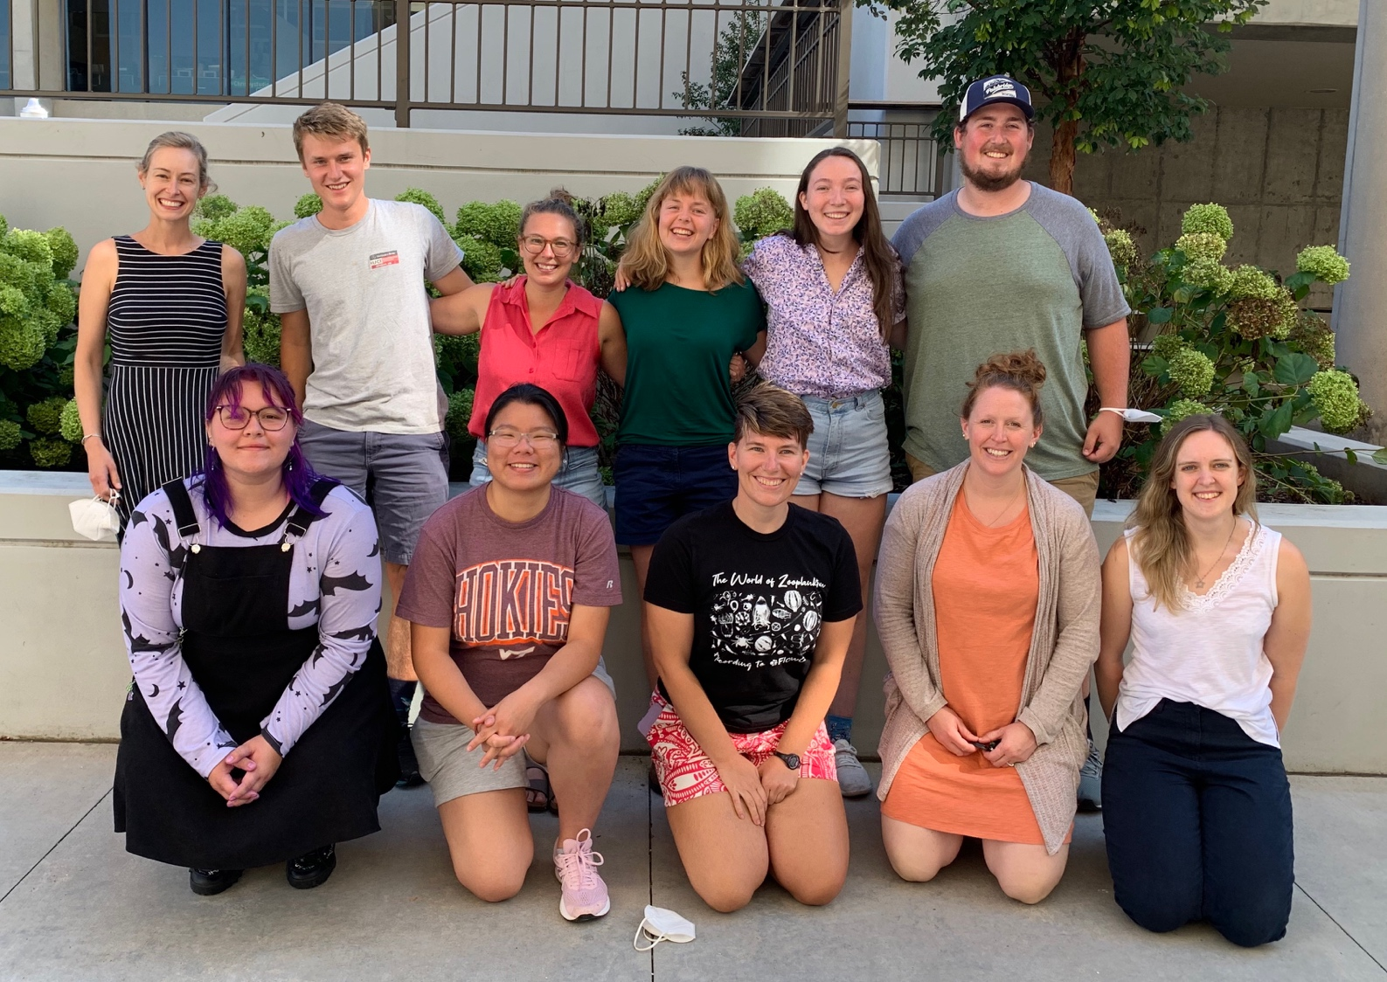






Many thanks to collaborators, data contributors, and funding sources for enabling this work!

Slide 14



aslewis@vt.edu
@lewis_lakes
@aslewis.bsky.social
Notes:
Add email address, etc

Slide 15
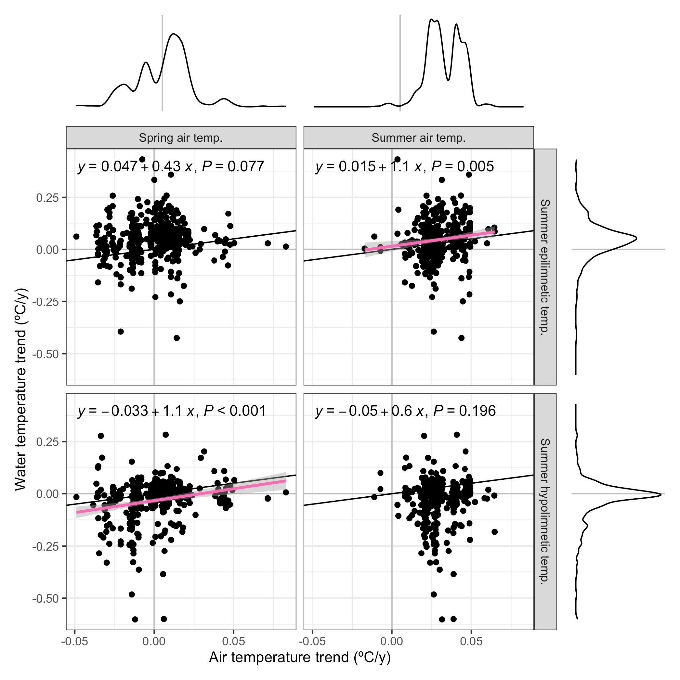
Spring, but not summer, air temperatures are correlated with late-summer bottom-water temperature and dissolved oxygen
Climate
Trends (across-lake)
Notes:
Cut distributions?

